Slide 1
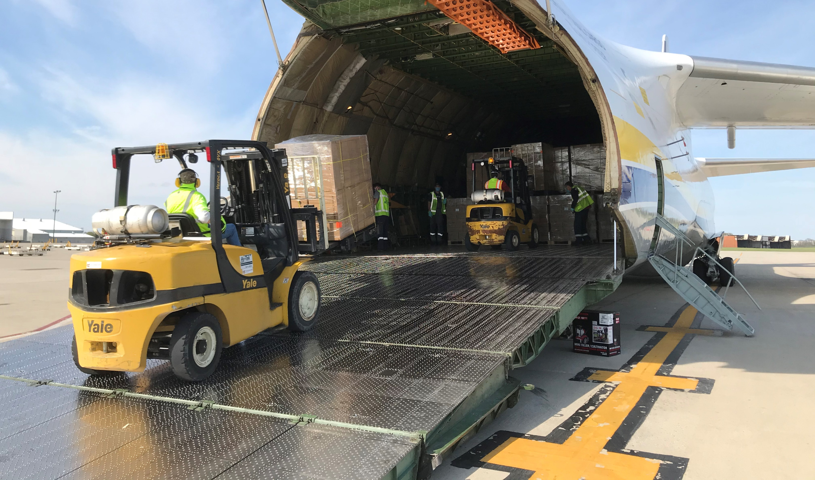

The Next Normal
Curtis D. Spencer
President
IMS Worldwide
May 21, 2020

Slide 2
Agenda, Discussion for Today
The Economy
Retail and e-commerce
Logistics and Transportation
Industrial Real Estate
What is the next normal?

Slide 3
The Economy
Unemployment: “staggering 14.7%” on 5/8 -highest level on record since the Great Depression
GDP: Q2 will decline 37% from April to June, largest quarterly drop since 1947.
CBRE expects Annual GDP to fall by 4.9% in 2020 but grow by 6.1% in 2021. Source: U.S. Economic Watch, May 8, 2020.
Notes:
“Any growth below 2% in the global economy is considered a recession”

Slide 4
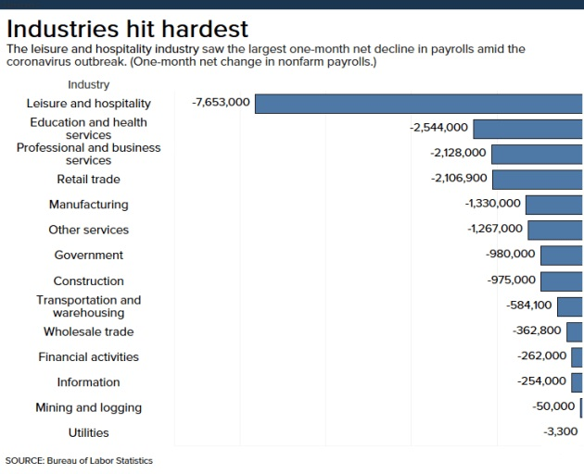
May 8, 2020

Slide 5
Retail and E-commerce
Amazon and Walmart
Neiman Marcus Bankruptcy…“more to come”
Supply chains and new technologies
Automobile Sales -30% in May overall from April (Toyota -54%) (Hyundai -39%) (Mazda – 44%) (Honda -54%)

Slide 6
Retail and E-Commerce Growth
United Parcel Service Inc. said home deliveries spiked nearly 70% by the end of March, with drivers making 15% more stops on their daily routes.
During the last week of March, mail-order prescriptions grew 21% from the previous year to bring their share of the prescription drug market to 5.8%, the highest share in at least two years. Source SunTrust Robinson Humphrey analyst Gregg Gilbert
In April, online giant Amazon.com Inc. reported a 26% jump in quarterly sales.
Overall U.S. e-commerce sales rose 49% in April compared to a March 1 to March 11 baseline, according to Adobe Analytics.

Slide 7
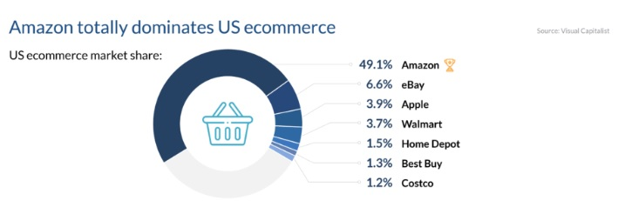

Slide 8
E-Commerce and Cold Chain Growth
Industrial real-estate operators expect the disruption of consumer supply chains caused by the coronavirus pandemic to drive a new surge in warehousing demand.
Demand could be particularly strong for temperature-controlled warehouse space to store food if consumers keep ordering groceries online, a market that has been booming as more people stay at home under social-distancing guidelines and have food delivered.
Over the next five years an additional 75 million to 100 million square feet of industrial freezer and cooler space will be needed to meet demand generated by online grocery sales, according to real-estate firm CBRE Group Inc.

Slide 9
E-commerce and Cold Chain Growth
While e-commerce now accounts for about 3% of total U.S. grocery sales, “there are huge growth prospects” as housebound shoppers get used to ordering produce, meat and other perishables online, said Matthew Walaszek, CBRE’s associate director of industrial and logistics research.
Walmart Inc. generated nearly $900 million in online grocery sales last month, up 21% compared with February and nearly double the level of March 2019, according to data provider 1010data, which tracks credit- and debit-card sales. Wall Street Journal, 4/13/20

Slide 10
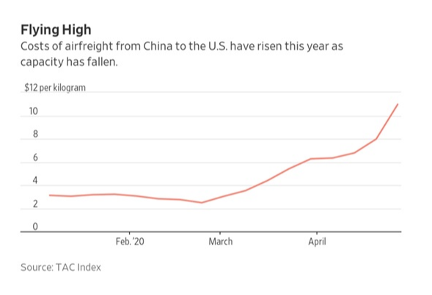
Air Cargo:
Asia-US Charter rates up to $1.5 million from $400,000 months ago for 747-Freighter
Rates per kilo up to $12.00/k from $2.45/k months ago.
IATA’s Alexandre de Juniac: “Half of the worlds air cargo once traveled in the belly of the passenger aircraft, now idled by the CV crash”

Slide 11
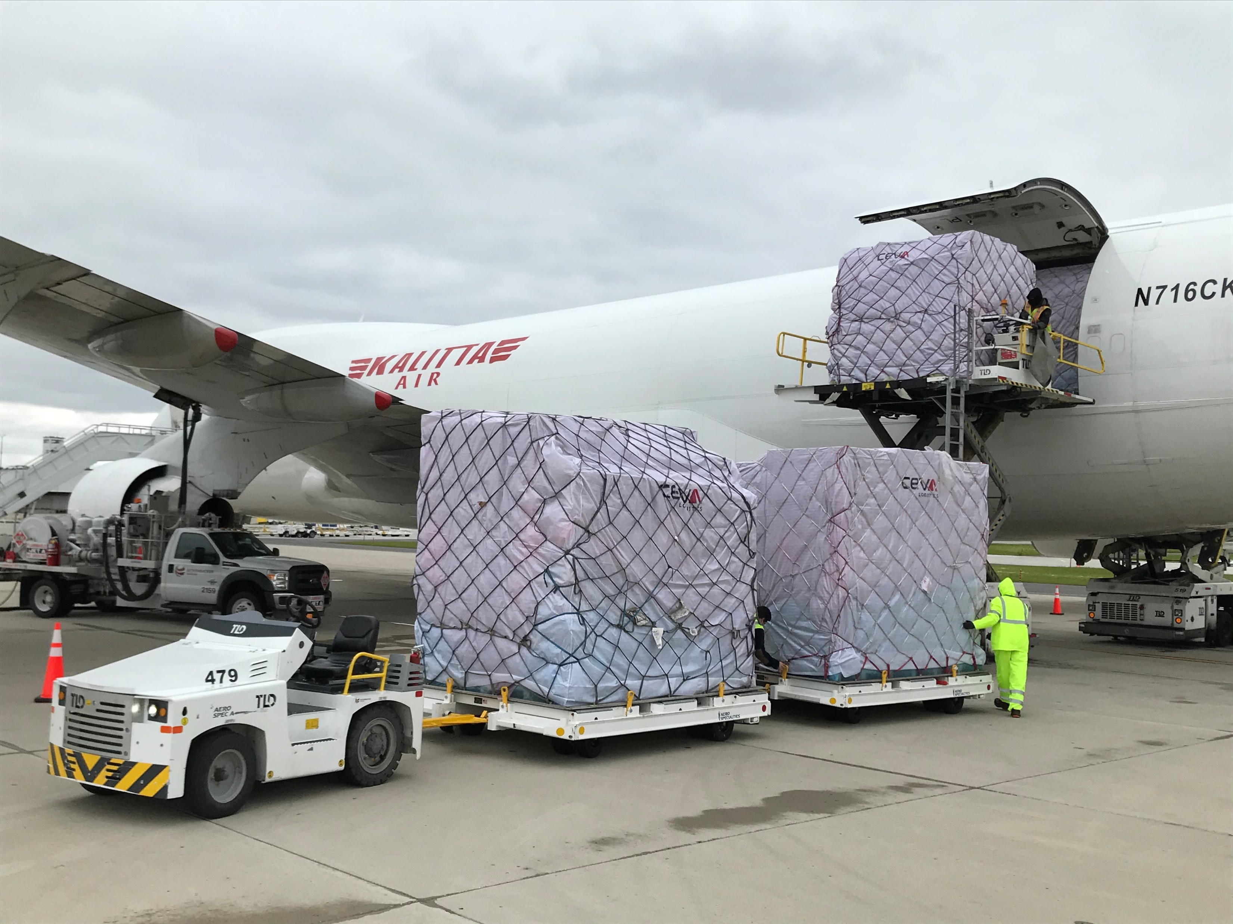

Slide 12
Logistics and Transportation
Ocean Cargo The ongoing impact of COVID-19 was on full display in the declining number of United States-bound waterborne shipments for the month of March, according to data recently issued by global trade intelligence firm Panjiva.
March shipments—at 829,501—were off 10.1% annually, falling for the seventh consecutive month. And on a year-to-date basis through March, U.S.-bound waterborne shipments—at 2,706,690—are down 6.8% annually.
Trucking: orders for Class 8 trucks down 73% from April 2019, and 44% from March 2019 (Wall Street Journal, 5/5/2020)
XPO Bradley Jacobs: “E-commerce saved our April, we had 9% organic revenue growth in our last mile business for the first quarter, people were inside, people were ordering”

Slide 13
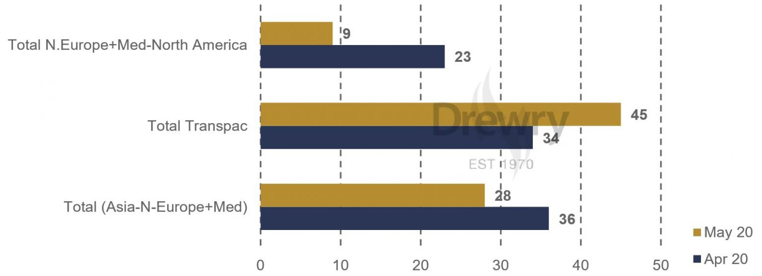
Overall the number of cancellations has decreased between April and May by 12%, apart from the Transpacific trade, where we see an increase of cancelled sailings of 32%. Total Cancelled Sailings: - Source: Drewry Cancelled Sailings Tracker

Slide 14
Shipping Fluctuations
There will be a review of "just in time" global supply chain systems.
Lowest-delivered cost will remain important, but no longer the only consideration.
At a minimum, safety stocks will be increased, and redundancy will be a requirement.
Diversification in sourcing, routing and distribution will be a requirement.
- Source: Larry Gross, Journal of Commerce 5/12/2020

Slide 15
Industrial Real Estate
David Egan, CBRE:
Each $1 Billion in new e-commerce spending drives a demand for 1.25 million SF of new industrial product
Total E-commerce percent of retail share was projected to be 14%, but now approaching 20% of total retail, this will require +400 million SF in future
5% increase in safety stock (near shoring or longer lead time expectation) will require another +700 million SF in new industrial in the future-expect that many companies will accelerate re-shoring
Signals are stable, low vacancies, not oversupplied, but the pace of deliver will slow in 2020-2021 but E-commerce adoption rate spiked in last months

Slide 16
The Next Normal
Two years before we return to 2019 air passenger volumes
E-commerce and safety stock will keep Industrial strong: JIT only works inside N. America---COVID proved that point!
Office will be impacted by the new work at home normal…..
Globalism versus nationalism impacts supply chains and sourcing
Social distancing becomes contract tracing; challenges privacy norms of today
Still places of great opportunity-Columbus Rickenbacker Airport ground zero for air cargo PPE distribution; Phoenix Metro for Manufacturing and W. Coast Fulfillment.

