Slide 1
Foreign Trade Zones
Curtis Spencer, IMSW
Notes:
Tray introduce Curtis

Slide 2
About IMS Worldwide Inc.
IMSW has completed over 375 FTZ projects during 45 years. We have conducted 50 logistics/drayage studies for industrial R.E. Firms, railroads and land-owners.
We work with large gateway zones (Houston, LA, Miami, Dallas, Chicago, Phoenix, El Paso and NJ)
We work with fortune 1000 companies: Target, The Limited, Dell, Home Depot, Abbott Labs, TJX, Dicks Sporting Goods, Ceva, FedEx, XPO, UPS, Yusen, NFI, Nippon Express, Etc.
We work with the largest REITs in the USA: Prologis, Duke, Panattoni, Transwestern, Trammel Crow, Majestic, Clarion, USAA, Div-Capital/IIT, etc.

Slide 3
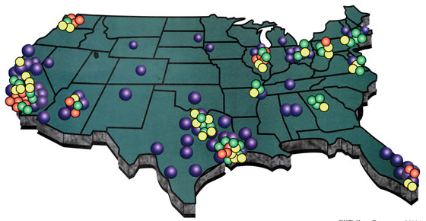
IMSW Overview of National FTZ and Strategic Development Projects 1977-2020

Slide 4
The Zone Program is Evolving in the Face of a Changing U.S. Economy
Over 6,000 companies use FTZs: Target, Home Depot, Levi’s, The Limited, Puma, Adidas and 1,000’s of retailers use FTZs in their Supply Chains to Cut Costs!
MPF Savings are the leading “rationale” for using FTZ’s; (DCs and FCs)
However, Manufacturing in Zones is making a come-back: Sub-Zero, GE Appliances, Maxwell Technologies, Tesla, Red Bull, White Claw etc. Anything to cut costs!
Trump Tariffs are driving companies to seek out FTZ designation to offset rising costs.

Slide 5
Key Drivers for Senior Management
FTZs are real Supply Chain cost reducers: They can take $300,000 to $1Millions out of costs.
FTZs are easier to manage now: Software has become simpler, all forms electronic, Brokerage is protected. Multiple locations operated from HQ!
FTZs are CTPAT “Best Practice”.
Weekly Entry offers huge savings to large-scale importers!
But, with the new China Tariffs (China 301 duties ++) this is also about super-high tariff rates.

Slide 6
Everyone in the USA is having to re-think their Supply Chains…
The US vowed to slap duties on up to $200 Billion of Chinese imports.
The Chinese did the same to US!
After the first $50 Billion, the next $200 Billion already hit Consumer Goods:
Apparel, Footwear, Electronics, Furniture, Sound Systems, cosmetics, tools and Hand-Bags!!
Our Ag Products, Planes, Hi-Tech goods, and Pharma are all going to be hit going to China.
This isn’t “maybe” anymore, it’s real and it’s now!
Wall Street Journal, July 12, 2018

Slide 7
How do we “insure” against current policy?
The USA has begun receiving $10X more in Duty Payments since 2018. Average duty now is 15%-20% not 2%.
The FTZ Program is the only way to carry “insurance” against a Tariff World that changes daily.
We have gotten DOUBLE the calls for FTZ use since this whole Tariff Sheriff business started!
So, in 2018 the FTZ Program was all about MPF savings; and now, it’s about Tariffs!
Even small Occupiers are feeling the pain.

Slide 8
How Do Company’s Qualify
Understanding the FTZ process is Step 1.
Determine if you meet ONE or more of…..
300,000 SF or more of DC space with imports, OR,
$100 Million in import value per year, OR,
1,000 Customs Entries or more, OR,
You import parts/components and manufacture, assemble or pick & pack!

Slide 9
Bingo – You Qualify
Call IMS Worldwide 281-554-9099
Use the www.imsw.com website.
IMSW will determine if there is a savings of more than 2:1 or more (we do the cost-benefits analysis, for free!).
Here is a perfect example of what we provide to C&W Brokers for their Customers…Can be completed on a conference call in 10 minutes!!

Slide 10
TYPICAL FTZ OPERATIONS: SMALL IMPORTER IN TEXAS

Slide 11
TYPICAL FTZ OPERATIONS: SMALL IMPORTER IN TEXAS

